Slide 1
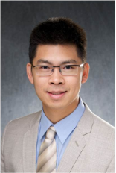


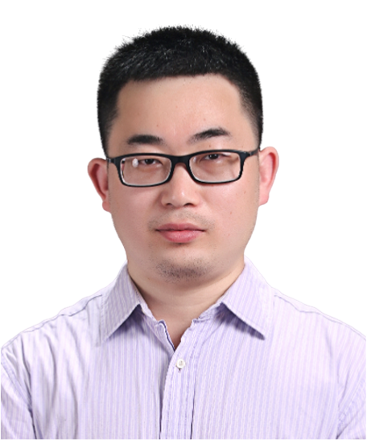
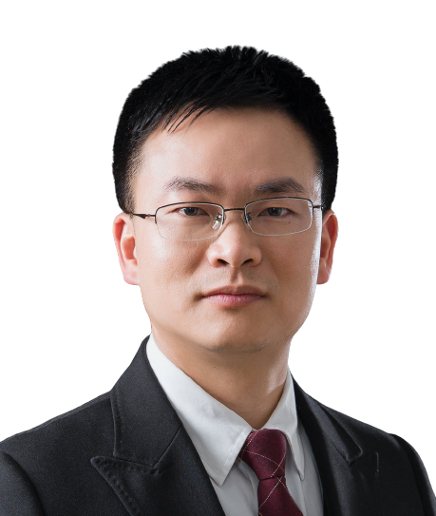
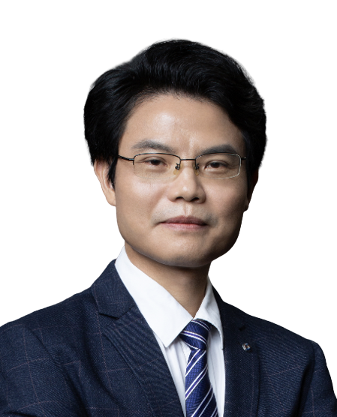
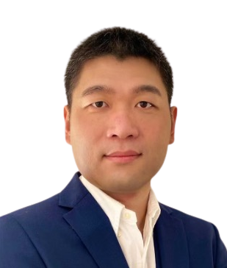
Long-read sequencing and new insights in transcriptomics and epigenetics
报告时间: 2024-5-23 10:00-11:00
腾讯会议: 749-316-975 哔哩哔哩：https://live.bilibili.com/26427894
区健辉
(Prof. Kin Fai Au)
美国密歇根大学教授
汇报人简介:
区健辉教授，2004年本科毕业于清华大学，2009年于牛津大学获得博士学位，2009年至2013年在斯坦福大学师从美国科学院院士Wing H. Wong教授从事博士后研究，2013年加入爱荷华大学建立实验室，2018年任职于俄亥俄州立大学，2023年加入密歇根大学担任终身正教授。主要从事测序数据(尤其是长读长数据)的生物信息学方法开发。近年来在Nature Biotechnology、Nature Methods、Nature Structural &Molecular Biology等期刊发表了多篇高水平论文。区教授是The Long-read RNA-seg Genome Annotation Assessment Project (LRGASP) Consortium的主要负责人之一，并且担任著名学术期刊Genome Biology及Genome Research的编委。
主持人和嘉宾
主持人：王金凯
中山大学
黄林
中山大学
杨建华
中山大学
苗智超
广州实验室
广州医科大学

Slide 2
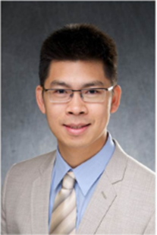


Long-read sequencing and new insights in transcriptomics and epigenetics
Time (China): 2024-5-23 10:00-11:00
Tencent meeting ID: 749-316-975 Bilibili: https://live.bilibili.com/26427894
Prof. Kin Fai Au
University of Michigan, USA
Abstract:
Long-read sequencing, aka Third Generation Sequencing/TGS (i.e.. Oxford Nanopore Technologies/ONT and Pacific Biosciences/PacBio) can generate single-molecule long reads, ranging from a few kb to million bp. These data have been demonstrated to be very powerful to address many complex biomedical problems that remained unsolved by short reads. For example, the extensive applications of TGS data for genome research have been published in various biomedical contexts. Here , I will present the methodological research of how long reads can advance transcriptome and epigenetics research and how their applications discovered new insights of transcript complexity and transposable elements in early embryonic development and stem cells.
HOST＆PANELISTS
Host：Jinkai Wang
Sun Yat-sen University
Lin Huang
Sun Yat-sen University
Jianhua Yang
Sun Yat-sen University
Zhichao Miao
Guangzhou Laboratory
Guangzhou Medical University

